Slide 1

Analyzing Sales Performance
and Profitability Across Regions
Using Interactive Tableau Dashboards
Python
Jupyter Notebook
Tableau
Global Superstore
Dataset: Global Superstore · Tools: Python & Tableau
Interactive Retail Analytics
using Tableau & Python
4 Yrs
3 Reg
51K+
3 Cat
Presented by: Arif Hussain, Haji Qasim,
& Rahmat Ullah
Data Span
Regions
Orders
Categories

Slide 2



Introduction & Problem Statement
Why interactive analytics matter for retail decision-making
Big Data Complexity
Static Reports Fall Short
Need for Interactivity
Retail datasets contain millions of transactions across regions, products, and time periods
Making manual analysis error-prone and slow.
Traditional Excel or PDF reports cannot adapt to changing business questions. Slicing by region or period requires rebuilding reports from scratch.
Stakeholders need live exploration — clicking on a region should instantly filter KPIs, trends, and category breakdowns without manual queries.
Solution: Build an interactive Tableau dashboard powered by clean Python-preprocessed Global Superstore data.

Slide 3

Dataset Overview
Global Superstore — a comprehensive multi-dimensional retail dataset
Global Superstore Dataset
51,290
3 Regions
A widely used sample retail dataset covering 4 years (2012–2015) of global transactions.
It simulates a multinational superstore with three product categories sold across multiple regions and customer segments.
Ideal for testing analytics, BI tools, and dashboard design.
Total Orders
US, EU, APAC
3 Categories
17 Sub-Cats
Tech, Furniture, Supplies
Product Sub-categories
Sourced from Kaggle — widely used in BI & analytics education.
3 Segments
4 Metrics
Consumer, Corp, Home Office
Sales, Profit, Discount, Ship

Slide 4



Data Preprocessing in Python
Cleaning and feature-engineering the dataset in Jupyter Notebook
→
→
→
Load Dataset
Handle Nulls
Date Parsing
Feature Eng.
Read CSV into
pandas DataFrame
Drop / fill missing
values, verify dtypes
Convert Order Date
to datetime, extract Year
Profit Ratio =
Profit / Sales
# Python Preprocessing Snippet (Jupyter Notebook)
df = pd.read_csv('Global_Superstore.csv') # Load data df.dropna(inplace=True) # Remove missing values df['Order Date'] = pd.to_datetime(df['Order Date']) # Parse dates df['Year'] = df['Order Date'].dt.year # Extract year df['Profit Ratio'] = df['Profit'] / df['Sales'] # Feature engineering
Clean schema exported as CSV → Connected to Tableau as live data source

Slide 5



Dashboard Design & Methodology
Tableau architecture, KPIs, and calculated fields
Dashboard Architecture
Calculated Fields
KPI Cards (Top Row)
Profit Margin = SUM(Profit) / SUM(Sales) — a custom metric enabling profitability analysis not available in raw data.
Total Sales · Profit · Orders · Margin
Trend Charts (Middle)
Top-Down Layout
Sales over Time · Category Breakdown
KPIs at top for at-a-glance metrics, detailed charts in the middle, and exploratory tables at the bottom.
Pie Charts (Right)
Geographic profit distribution
Segment Filters
Detail Table (Bottom)
Filter actions by Region, Segment, and Year using Tableau parameter controls connected to all worksheets.
Sub-category level drill-down

Slide 6
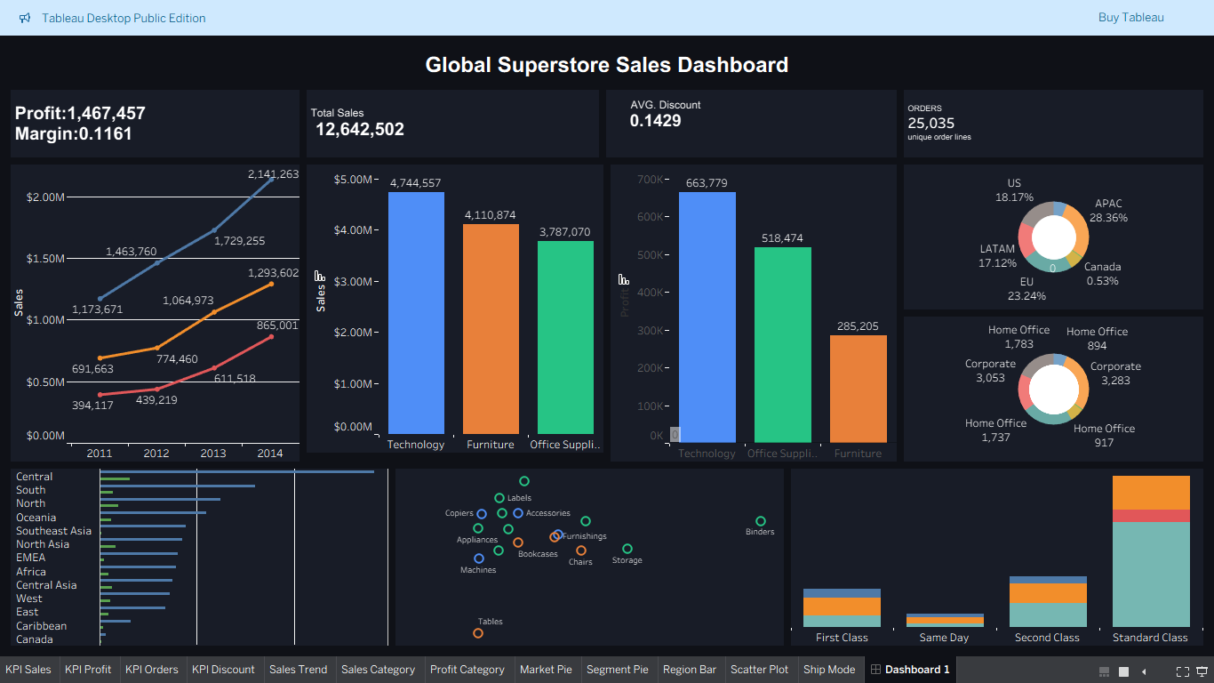
Dashboard Interactivity
Cross-filtering, highlight actions, and dynamic KPI updates
Cross-Filter
Dynamic KPIs
Click any chart element to filter all other views simultaneously
KPI cards recalculate in real-time based on active selections
Highlight Actions
Exploratory Analysis
Hover on a region or segment to highlight related data points
Drill from country level to city level with parameter controls
All four interaction types work simultaneously — creating a seamless exploratory analytics experience.

Slide 7
Key Finding 1: Sales Trends (2012–2015)
Consistent growth across all segments — Consumer segment leads throughout
+78%
Consumer Segment Growth
(2012–2015)
$507K
Peak Consumer Sales
in 2015
3/3
Segments show
consistent upward trend
Consumer segment consistently dominates — signaling where marketing investment has greatest ROI.

Slide 8


Key Finding 2: Profitability by Category
Furniture generates high sales but suffers from poor or negative margins
Technology
Highest profit margin. Strategic products drive overall revenue performance.
Furniture ⚠
Negative profit despite high sales. Discount abuse and high shipping cost are root causes.
Key Takeaway
High sales does not equal high profit. Category-level margin analysis is critical.

Slide 9
Key Finding 3: Discount vs. Profit
Higher discounts consistently erode profitability across all categories
–0.82
Pearson Correlation
Strong negative correlation
30%+
Discount Threshold
Orders turn unprofitable above this
68%
Negative-Margin Orders
Had discount of 30% or more applied
Discount strategy needs urgent review

Slide 10



Business Insights
How dashboard interactivity revealed regional and category-level patterns
Regional Gaps
Category Divergence
APAC region shows high order volume but significantly lower profit margins than US, suggesting pricing inefficiency or excessive discounting.
Furniture sub-categories like Tables and Bookcases are net-negative contributors — invisible in static totals without cross-filtering.
Discount Abuse
Consumer Segment Potential
Specific customer segments receive discounts far exceeding the profitable threshold. The interactive scatter plot makes this cluster instantly visible.
Consumer segment drives the most growth year-over-year. Targeted investment here yields the highest incremental return on marketing spend.
Interactive exploration turned data into actionable strategy — impossible with static reports.

Slide 11


Conclusion & Recommendations
Key outcomes and strategic actions from the interactive dashboard analysis
The interactive Tableau dashboard, built on Python-preprocessed Global Superstore data, revealed critical business insights invisible in static reports — enabling faster, data-driven decisions at regional and category level.
Optimize Discount Strategy
Monitor by Category & Region
Cap discounts at 20% for Furniture and Office Supplies. Implement approval workflows for orders exceeding the profitable discount threshold.
Establish monthly profitability reviews at sub-category and regional level. Use dashboard drill-down to identify underperforming cells.
Invest in Consumer Segment
Expand Dashboard Coverage
Prioritize marketing budget in the Consumer segment. Consistent YoY growth across all regions makes it the highest ROI segment.
Integrate logistics data to analyze shipping cost impact. Add forecasting worksheets using Tableau's built-in trend modeling capabilities.

Slide 12

Thank You
Questions?
● Global Superstore dataset analyzed with Python & Tableau
● Interactive dashboards reveal regional & category insights
● Discount strategy and Furniture margins require urgent action
Python
Tableau
Jupyter
[Presenter Name] · IEEE Conference · 2024

